Slide 1
ITMD 421 – Data Modeling and Applications
Aastha Gupta
Lecture 4
September 18, 2017

Slide 2
Objectives
Tool – MySQL workbench
Basic SELECT operations
WHERE Clause
Logical Operators

Slide 3
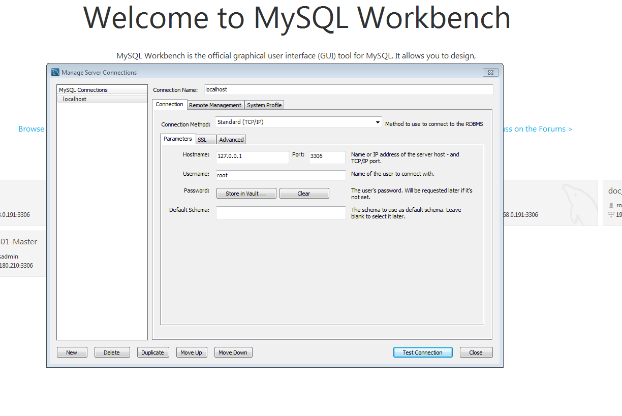
Setting up the connection

Slide 4
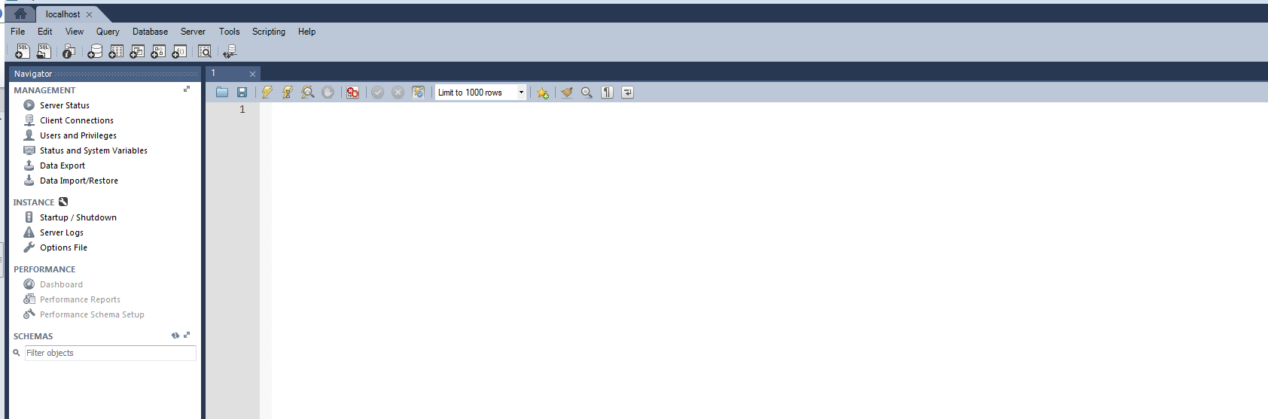
Run SQL script file

Slide 5
Basic SELECT Statement
SELECT *|{[DISTINCT] column [alias],...}
FROM table;
SELECT identifies the columns to be displayed.
FROM identifies the table containing those columns.

Slide 6

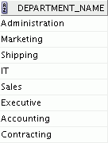
SQL
The ANSI standard language for operating relational databases
Efficient, easy to learn, and use
Functionally complete (With SQL, you can define, retrieve, and manipulate data in tables.)
SELECT department_name
FROM departments;
MySQL server

Slide 7
SQL Statements - Categories
Data Manipulation Language (DML)
SELECT
Data Control Language
GRANT
INSERT
UPDATE
DELETE
MERGE
Data Definition Language (DDL)
CREATE
ALTER
DROP
RENAME
TRUNCATE
COMMENT
REVOKE
Transaction Control
COMMIT
ROLLBACK
SAVEPOINT

Slide 8
Selecting All Columns
SELECT identifies the columns to be displayed.
give a single attribute, or a list
* for all attributes
DISTINCT will only report distinct tuples
FROM identifies the table containing those columns.
SELECT *|{[DISTINCT] column [alias],...}
FROM table;

Slide 9
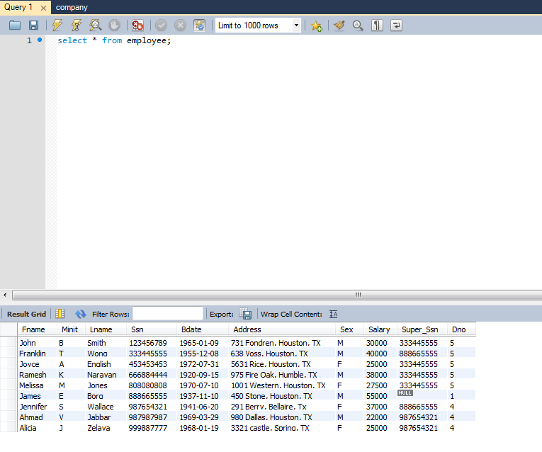
Selecting All Columns
SELECT * FROM EMPLOYEES;

Slide 10
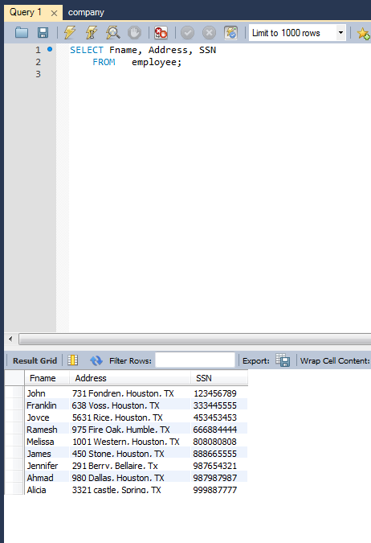
Selecting Specific Columns
SELECT Fname, Address, SSN
FROM employee;

Slide 11
Writing SQL Statements
SQL statements are not case-sensitive.
SQL statements can be entered on one or more lines.
Keywords cannot be abbreviated or split across lines.
Clauses are usually placed on separate lines.
Indents are used to enhance readability.

Slide 12
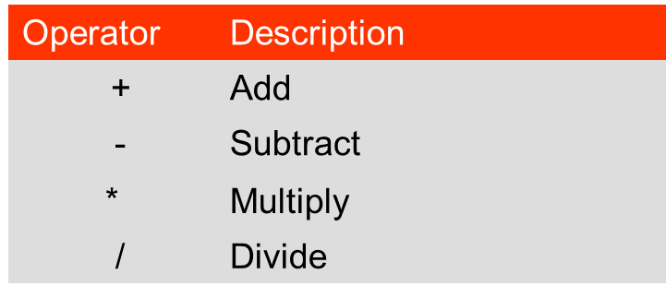
Arithmetic Expressions
Create expressions with number and date data by using arithmetic operators.

Slide 13
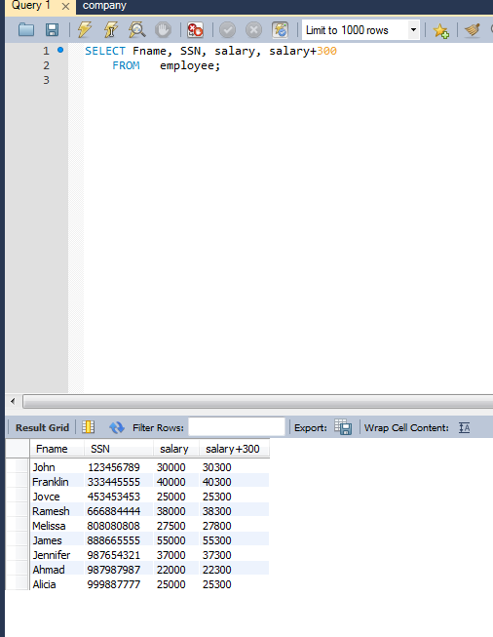
Using Arithmetic Operators
SELECT Fname, SSN, salary, salary+300
FROM employee;

Slide 14
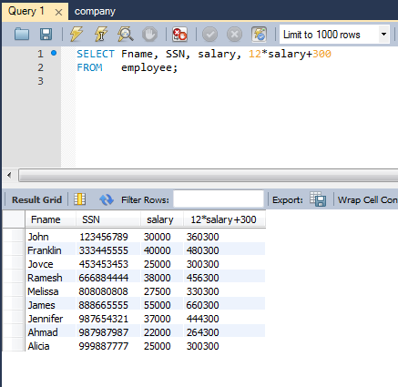
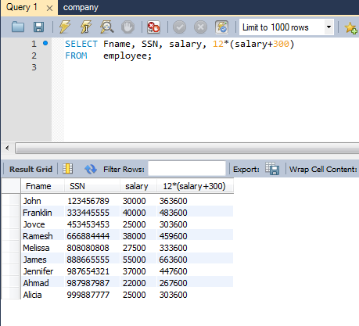
Operator Precedence
SELECT Fname, SSN, salary, 12*salary+300
FROM employee;
SELECT Fname, SSN, salary, 12*(salary+300)
FROM employee;

Slide 15
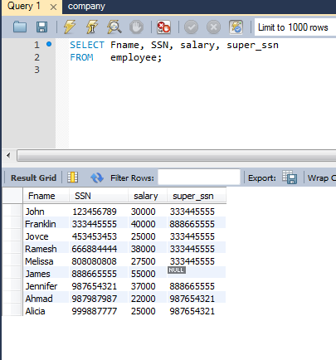
Defining a Null Value
Null is a value that is unavailable, unassigned, unknown, or inapplicable.
Null is not the same as zero or a blank space.

Slide 16
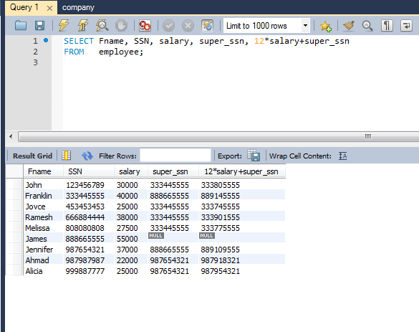
Null Values in Arithmetic Expressions
Arithmetic expressions containing a null value evaluate to null.

Slide 17
Defining a Column Alias
A column alias:
Renames a column heading
Is useful with calculations
Immediately follows the column name (there can also be the optional AS keyword between the column name and the alias)
Requires double quotation marks if it contains spaces or special characters, or if it is case-sensitive

Slide 18
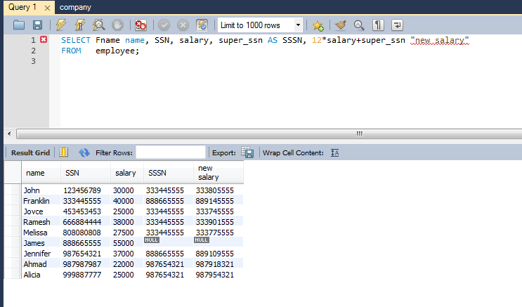
Using Column Alias

Slide 19
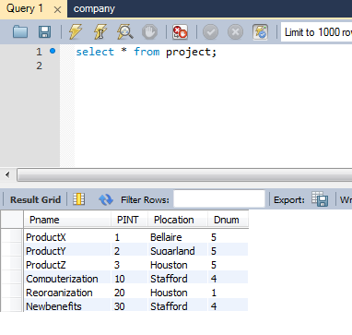
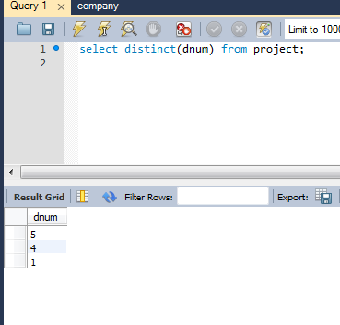
Duplicate Rows
The default display of queries is all rows, including duplicate rows.

Slide 20
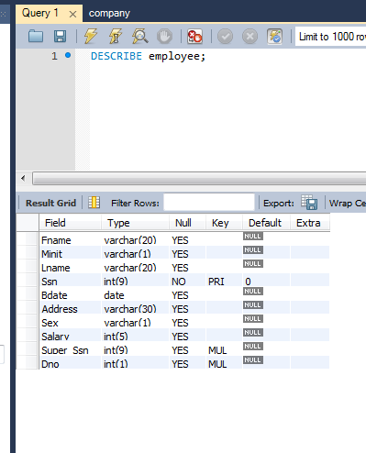
Displaying Table Structure
Use the DESCRIBE command to display the structure of a table.
Or, select the table in the Connections tree and use the Columns tab to view the table structure

Slide 21
Agenda
Limiting rows with:
The WHERE clause
The comparison operators using =, <=, BETWEEN, IN, LIKE, and NULL conditions
Logical conditions using AND, OR, and NOT operators
Rules of precedence for operators in an expression
Sorting rows using the ORDER BY clause
SQL row limiting clause in a query

Slide 22
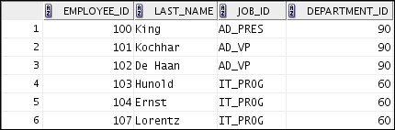

Limiting Rows by Using a Selection
EMPLOYEES
…
“retrieve all employees in department 90”

Slide 23
Limiting Rows That Are Selected
Restrict the rows that are returned by using the WHERE clause:
The WHERE clause follows the FROM clause
SELECT *|{[DISTINCT] column [alias],...}
FROM table
[WHERE logical expression(s)];

Slide 24
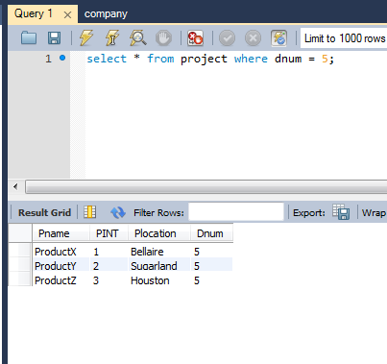
Using the WHERE Clause
select * from project where dnum = 5;

Slide 25
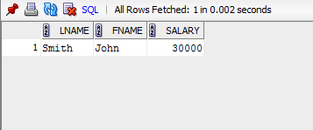

Character Strings and Dates
Character strings and date values are enclosed within single quotation marks.
Character values are case-sensitive and date values are format-sensitive.
The default date display format is YYYY-MM-DD.
SELECT lname,fname,Salary
FROM employee
WHERE lname = 'Smith';
SELECT last_name
FROM employees
WHERE hire_date = '17-OCT-03' ;

Slide 26
Comparison Operators
Operator
Meaning
=
Equal to
>
Greater than
>=
Greater than or equal to
<
Less than
<=
Less than or equal to
<>
Not equal to
BETWEEN ...AND...
Between two values (inclusive)
IN(set)
Match any of a list of values
LIKE
Match a character pattern
IS NULL
Is a null value

Slide 27
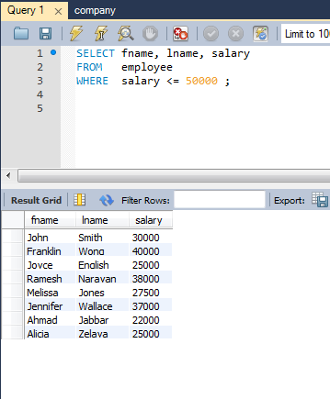
Using Comparison Operators

Slide 28
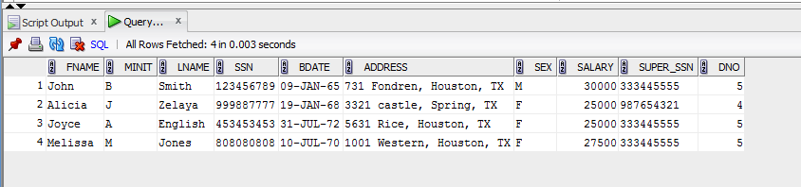
BETWEEN Operator
Use the BETWEEN operator to display rows based on a range of values:
SELECT last_name, salary
FROM employees
WHERE salary BETWEEN 25000 AND 35000 ;
Lower limit
Upper limit

Slide 29
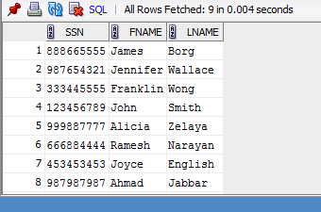
IN Operator
Use the IN operator to test for values in a list:
select ssn,fname,lname
from employee
WHERE Dno IN (1,4,5);

Slide 30
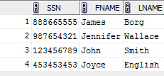
LIKE Operator
Use the LIKE operator to perform wildcard searches of valid search string values.
Search conditions can contain either literal characters or numbers:
% denotes zero or more characters.
_ denotes one character.
select ssn,fname,lname
from employee
WHERE fname LIKE 'J%';

Slide 31
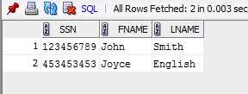
Combining Wildcard Characters
You can combine the two wildcard characters (%, _) with literal characters for pattern matching:
select ssn,fname,lname
from employee
WHERE fname LIKE '_o%';

Slide 32

NULL Conditions
Test for nulls with the IS NULL operator.
select ssn,fname,lname,super_ssn
from employee
WHERE super_SSN is NULL;

Slide 33
Logical Operators
Operator
Meaning
AND
Returns TRUE if both component conditions are true
OR
Returns TRUE if either component condition is true
NOT
Returns TRUE if the condition is false

Slide 34

AND Operator
AND requires both the component conditions to be true.
select *
from employee
WHERE salary >= 10000
AND Dno = 4;

Slide 35
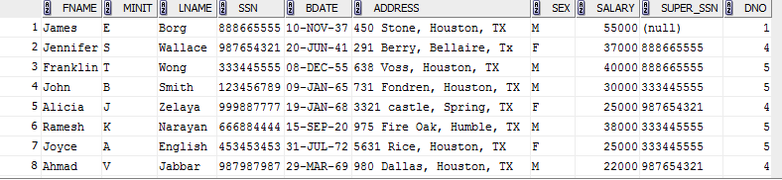
OR Operator
OR requires either component condition to be true:
select *
from employee
WHERE salary >= 10000
OR Dno = 4

Slide 36
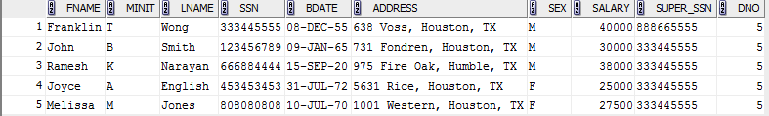
NOT Operator
select *
from employee
WHERE Dno NOT IN (1,4);

Slide 37
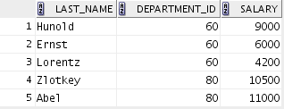

SELECT last_name, department_id, salary
FROM _id = 60
OR demployees
WHERE departmentepartment_id = 80
AND salary > 10000;
SELECT last_name, department_id, salary
FROM employees
WHERE (department_id = 60
OR department_id = 80)
AND salary > 10000;

Slide 38
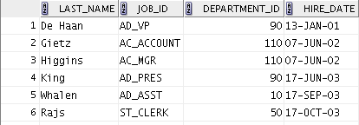
ORDER BY Clause
Sort the retrieved rows with the ORDER BY clause:
ASC: Ascending order, default
DESC: Descending order
SELECT last_name, job_id, department_id, hire_date
FROM employees
ORDER BY hire_date ;

Slide 39
THANK YOU!!

